Slide 1

X PUPIL SUPPORT

Slide 2
Scottish Government Inclusion Statement
Inclusive education in Scotland starts from the belief that education is a human right and the foundation for a more just society. An inclusive approach which recognises diversity and holds the ambition that all children and young people are enabled to achieve to their fullest potential is the cornerstone to achieve equity and excellence in education for all of our children and young people.

Slide 3
JGHS Pupil Support Structure February 2025
Ian Porter DHT Pupil Support
SfL Teacher: Fiona Oatman
Lauder
DHT Community Head: Deirdre O’Brien
PSL for all year groups ending in L1/2/3 or Key Adult -LA&B classes - Caitlin Garrett
PSL for all year groups ending in L4/5/6 or Key Adult LC&D classes - Sarah Britton
SfL Teacher: Leesa Fallon
Roslin
DHT Community Head: Nigel Cotter
PSL for all year groups ending in R1/2/3 or Key Adult RA&B classes - Bryan McPhail
PSL for all year groups ending in R4/5/6 or Key Adult RC&D classes - Cait Pearce (Laurie Crawford temp)
SfL Teacher: Robin Andrews
Spylaw
DHT Community Head: Laura Stewart
PSL for all year groups ending in S1/2/3 or Key Adult SA&B classes – Nikki Graham
PSL for all year groups ending in S4/5/6 or Key Adult SC&D classes - Elisa Kerr
Lauder
Roslin
Spylaw
Darach
        Gaelic DHT & Community Head: Donna Maciver
PSL for all Gaelic students (D1&2 classes) - Alasdair Alexander (Ronan Docherty Friday only)
SFL for all Gaelic students (D1&2 classes) Maria Moreno

Slide 4
JGHS Inclusion X
WBH
SNUG
CL: Chelsea Ewing
PSO: Jacque Swartz
PSA Darroch Angelina Hadshieva
Roslin
Inclusion Teacher: Anna Kirkwood
PSA: Andrew Whyte
Spylaw
Rob Cockcroft & Team
PSA Aisling Mitchell
PSO: Jordan Sinclair
Open to all year groups
Working closely with enhanced support team
Open to all year groups
Open to S1-S3
SNUG
Identified at PS
Enhanced Support Provision
SfL
Mental
Health
Supports
School Counsellors Sharon McAree Thomas & Kathryn Drever
PEF
DO Raing attainment: James Gunn
PSO Attendance: Joao Reis

Slide 5
STRANDS OF SUPPORT
Universal (All inclusive & Expected)
Targeted (Proactive & Supportive)
Intensive (Reactive & Responsive)

Slide 6
JGHS INCLUSION X PUPIL SUPPORT
The “X” signifies a collaboration and stands for by/ with/ through.
It establishes a partnership, as both entities will collaborate on what is aiming to be achieved.
So what our Inclusion X Pupil Support means is
Inclusion by/with/through the provision of Support for our Pupils
Inclusion Collaborative
Inclusion X for short

Slide 7
JGHS Inclusion X Vision
- Involves everyone supporting our young people
SFL & EAL
SNUG- Enhanced Support
MH/WBH Support & Counselling
Pupil Equity Support
PSLs/ Community Teams
L&T
L&T
Young People
L&T

Slide 8
Need for more intensive support -
Previous audits
School Year​ | School Roll​ | Numbers of young people struggling​ and in need of additional supports | %​
2019​ | 1,318​ | 272​ | 20.6% - 1 in 5​
2022​ | 1,519​ | 547​ | 36% Over 1 in 3​
2023 | 1,546 | 657 | 42.5%
2024 | 1,680 (1800 by August) | 600 | 36%

Slide 9
Referring for Supports
Pupil Self-Referrals
Staff Referrals
PSL/Community Team Referrals

Slide 10
Legislative framework and policy drivers
It is the responsibility of all who work with children to respond appropriately to their needs.
Recognising early signs of difficulties and adapting learning and teaching approaches are a regular part of the daily routine for teachers and colleagues supporting all children in an education environment.
Effective assessment, planning, action and review, consistent with the values and principles of Curriculum for Excellence, the Getting it right for every child (GIRFEC) approach, the Early Years Framework and legislation.
This inclusive approach not only allows children and young people to thrive in their community but also contributes to all children and young people’s understanding and appreciation of diversity and helps to build a more just society.

Slide 11
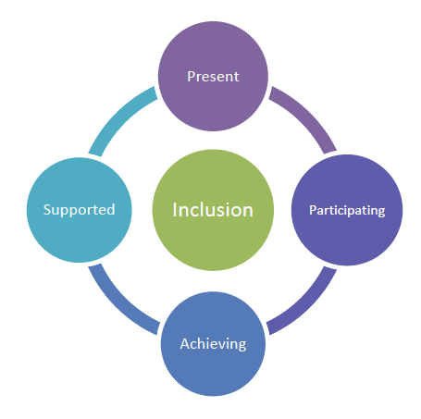

Slide 12
"Collaborative working supports inclusive practice. Effective collaboration is underpinned by a clear mutual focus on meeting the needs of individuals. It is supported by clear lines of communication, and a shared understanding of roles and responsibilities". Education Scotland

Slide 13
Inclusion Collaborative
Roles & Responsibilities of Class Teachers
Task 1:
To gather your input on what the responsibilities are in your role as classroom teachers in each of the following 3 strands of support:

Slide 14
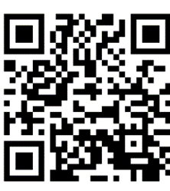
In small groups, please use this QR code on an ipad to complete the task:
You will have 5 minutes for each strand to enter your comments
Inclusion X Padlet
Inclusion X Roles & Responsibilities of classroom teachers

Slide 15
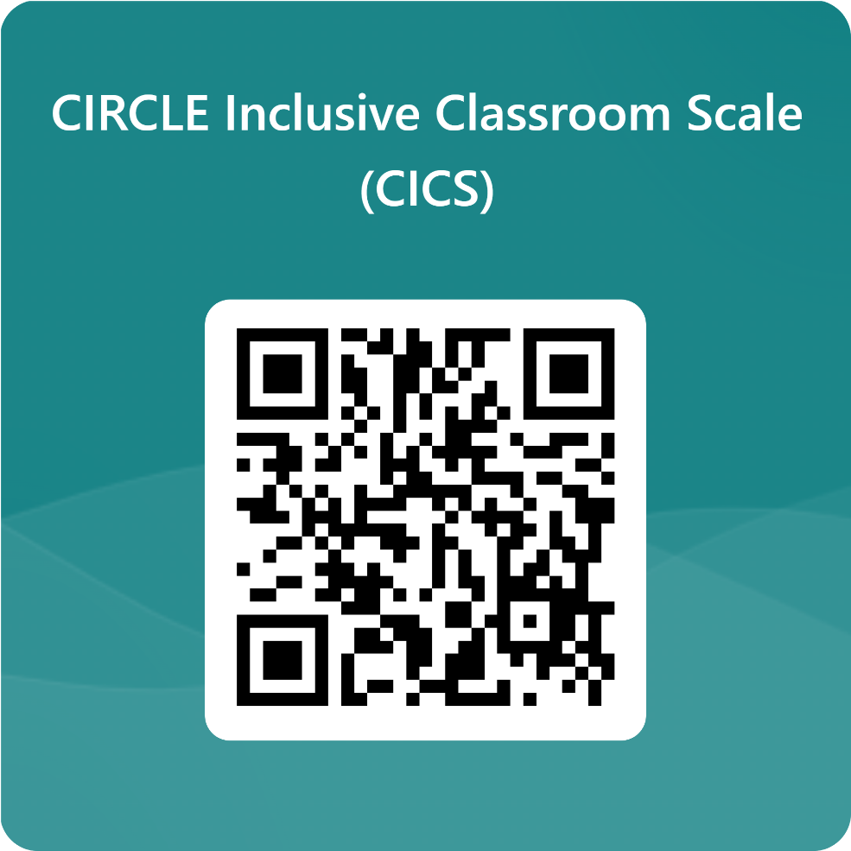
Task 2: Circle CICS Form
We now need your input to help us prioritise and improve
Please complete the following Form at Department tables. If incomplete at the end of this session, (likely) please complete either within the first hour of allocated department time today or submit your departmental return by Wednesday 30th October
Each department must nominate one member of their team to liaise with our Enhanced support team on provision of suitable curriculum materials at early/ first levels for your subject
Circle Inclusive Classroom Scale

